Slide 1
Finalize tables created from Import Wizard
The Sister Cities Database
Development Project

Slide 2
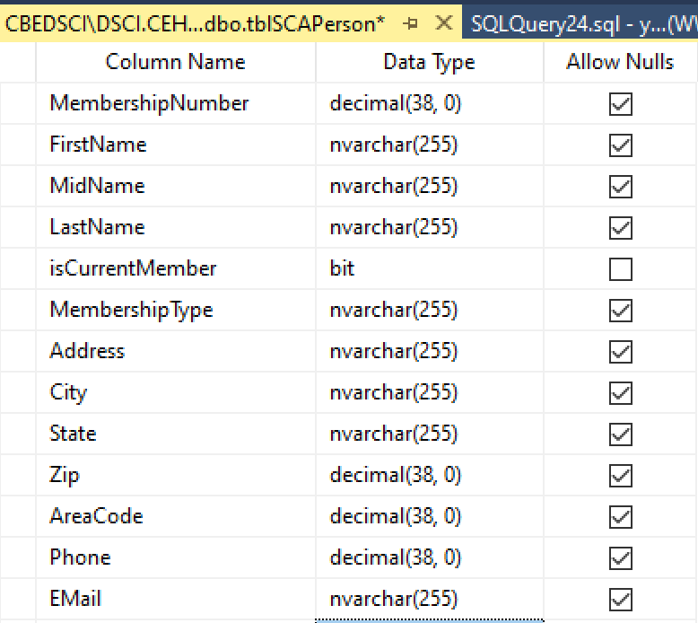
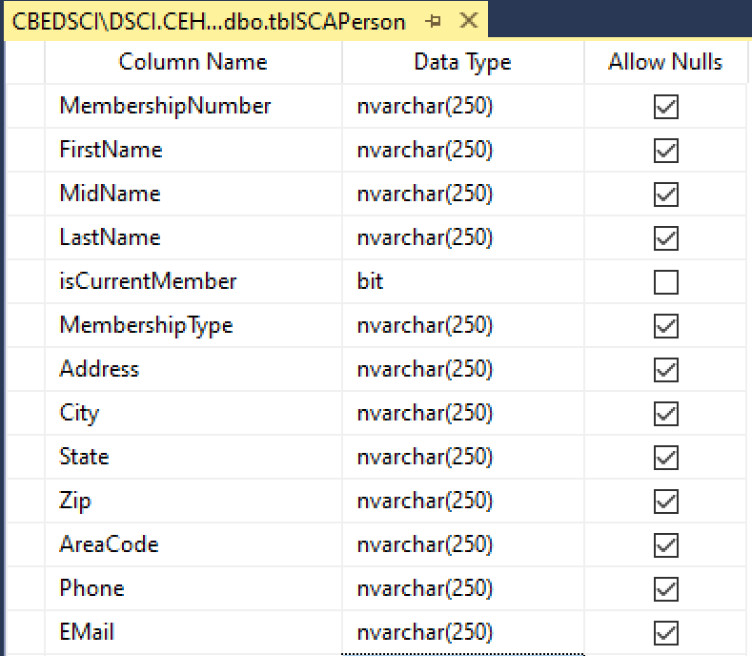
Modify the Table
Rt-click on the table
Select “Design”
Change the attributes’ Data Type, then the size: Example: char(255)→nvarchr(250) (the actual size should follow the class convention)

Slide 3
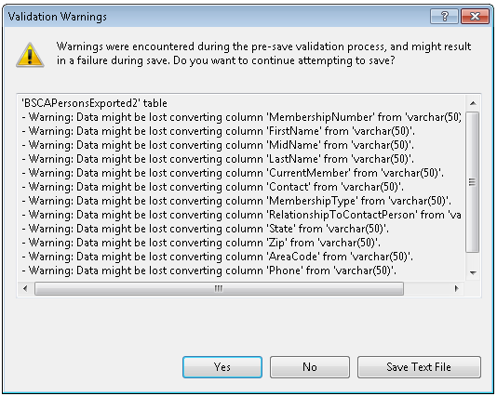
There be “Warnings”
Because the field sizes have been changed, the wizard may warn you that some data may be lost.
Click “Yes”, then check your data (next slide).

Slide 4
Verify the Results
Inspect the table (right-click table name, choose Select Top 1000 Rows)
Data in expected columns
Numeric data format, ensure no loss
Character data, check for truncation

Slide 5
Add the Primary Key
Nearly all “production” tables need a PK.
Often the PK will be an identity field.
On the left panel of the SCA website you will find a useful link. “How to … Create Identity PKs”. This link takes you to a page that explains how to make an identity PK (a.k.a. an “autonumber” field or an “auto-increment” field).

Slide 6
Save the design changes
After all changes have been made, click the button
to save the design changes.
You may be prompted with the following error message:
"Saving changes is not permitted. The changes you have made require the following tables to be dropped..."
If that is the case, at the left navigation pane of the SCA Project Website click the link “Set up certain SSMS options” for instructions of how to allow saving changes.

